Slide 1
Texture & Shading

Slide 2
Texture
Texture Types
Bitmap textures: Using some image file
Procedural textures: Changing pixel intensity in some controlled fashion without using external image source
Texture(s, t): produces a color or intensity value for each value of s and t between 0 and 1.

Slide 3
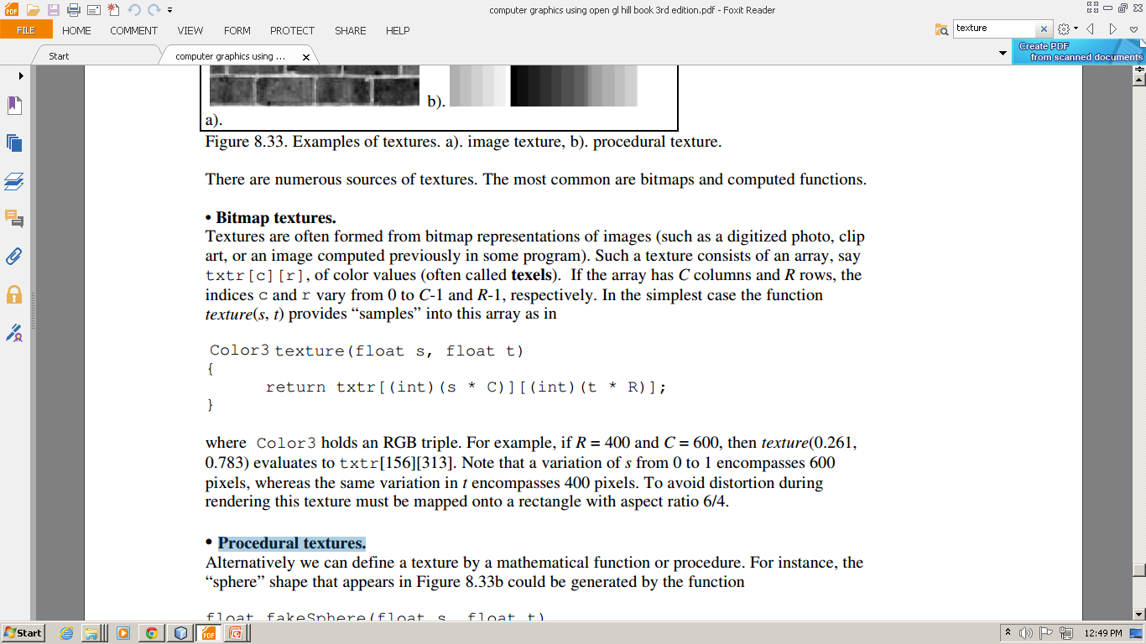
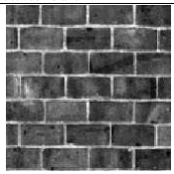
Texture
Bitmap textures: Using some image file having dimension CxR presented as txtr[c][r]
0<=c<=C-1 and 0<=r<=R-1
Example: R= 400 and C= 600 texture(0.261,0.783) evaluates to txtr[156][313] texture(1,1) evaluates to txtr[600][400]

Slide 4
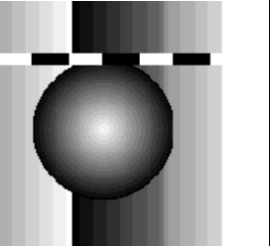
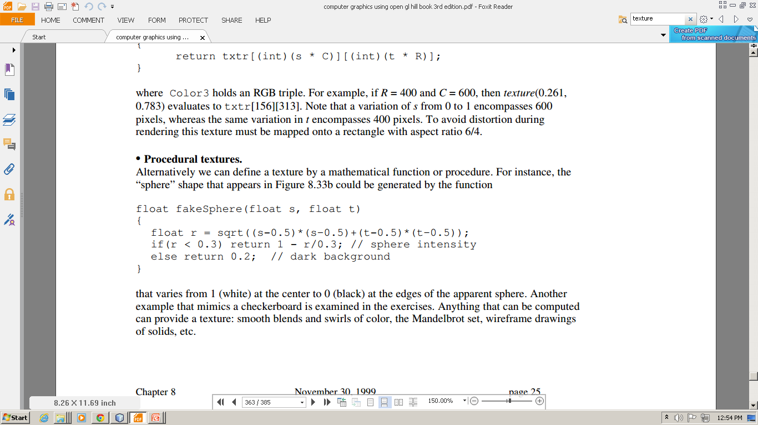
Texture
Procedural textures: Changing pixel intensity in some controlled fashion without using external image source
Not used frequently
(We will mostly deal with bitmap textures that is image files)

Slide 5
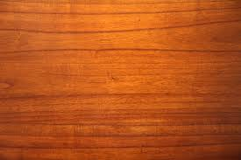
Texture
Adding Texture to flat surface
Texture P and Surface S has
same shape
Same number of vertices
Attaching a P_{i} to each V_{i}
P₂(0,1)
P₃(1,1)
V₂
V₃
P₁(0,0)
P₄ (1,0)
V₁
V₄
T(s,t)

Slide 6
Texture
Adding Texture to flat surface
Texture P and Surface S has same shape
glBegin(GL_QUADS);
glTexCoord2f(0.0, 0.0); glVertex3f(1.0, 2.0, 1.5);
glTexCoord2f(0.0, 1.0); glVertex3f(1.0, 3.0, 1.5);
glTexCoord2f(1.0, 1.0); glVertex3f(2.0, 3.0, 1.5);
glTexCoord2f(1.0, 0.0); glVertex3f(2.0, 2.0, 1.5);
glEnd();
0,1
1,1
Without distortion
=
0,0
1,0

Slide 7
Texture
Adding Texture to flat surface
Texture P and Surface S has same shape
glBegin(GL_QUADS);
glTexCoord2f(0.0, 0.0); glVertex3f(1.0, 2.0, 1.5);
glTexCoord2f(0.0, 0.5); glVertex3f(1.0, 3.0, 1.5);
glTexCoord2f(0.5, 0.5); glVertex3f(2.0, 3.0, 1.5);
glTexCoord2f(0.5, 0.0); glVertex3f(2.0, 2.0, 1.5);
glEnd();
0,1
1,1
stretched
=
0,0
1,0

Slide 8
Texture
Adding Texture to flat surface
Texture P and Surface S has same shape
glBegin(GL_QUADS);
glTexCoord2f(0.0, 0.0); glVertex3f(1.0, 2.0, 1.5);
glTexCoord2f(0.0, 2.0); glVertex3f(1.0, 3.0, 1.5);
glTexCoord2f(2.0, 2.0); glVertex3f(2.0, 3.0, 1.5);
glTexCoord2f(2.0, 0.0); glVertex3f(2.0, 2.0, 1.5);
glEnd();
2.0
Tile
0,1
1,1
1.5
=
0,0
1,0

Slide 9
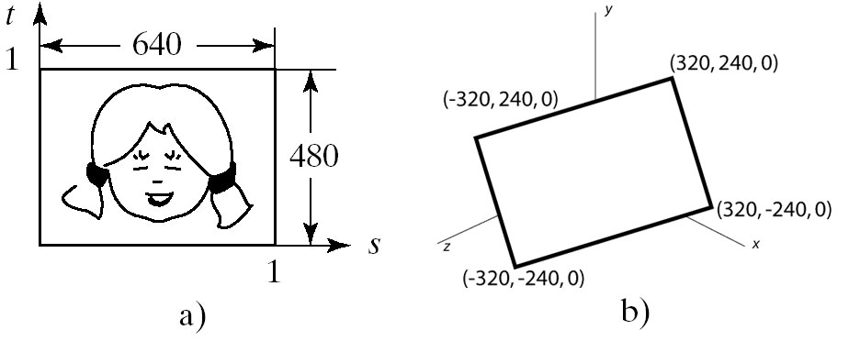
Texture
Adding Texture to flat surface
Texture P and Surface S has same shape
Mapping is clearly affine
Scaling
Rotation
Translation.

Slide 10

Creating Visual effect using Texture
Creating a glowing object
I = texture(s, t)
gl.glEnable(GL.GL_TEXTURE_2D);
gl.glTexEnvf(GL.GL_TEXTURE_ENV, GL.GL_TEXTURE_ENV_MODE, GL.GL_REPLACE);
gl.glBindTexture(GL.GL_TEXTURE_2D, texName);
glBegin(GL_QUADS);
glTexCoord2f(0.0, 0.0); glVertex3f(1.0, 2.0, 1.5);
glTexCoord2f(0.0, 1.0); glVertex3f(1.0, 3.0, 1.5);
glTexCoord2f(1.0, 1.0); glVertex3f(2.0, 3.0, 1.5);
glTexCoord2f(1.0, 0.0); glVertex3f(2.0, 2.0, 1.5);
glEnd();
=
replaces colour and alpha with that of the texture.

Slide 11
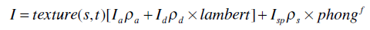
Creating Visual effect using Texture
Modulating the reflection coefficient
Object is the color of
Reflected diffuse light component
Reflected ambient light component
gl.glEnable(GL.GL_TEXTURE_2D);
glTexEnvf(GL_TEXTURE_ENV,GL_TEXTURE_ENV_MODE, GL_MODULATE);
gl.glBindTexture(GL.GL_TEXTURE_2D, texName);
glBegin(GL_QUADS);
glTexCoord2f(0.0, 0.0); glVertex3f(1.0, 2.0, 1.5);
glTexCoord2f(0.0, 1.0); glVertex3f(1.0, 3.0, 1.5);
glTexCoord2f(1.0, 1.0); glVertex3f(2.0, 3.0, 1.5);
glTexCoord2f(1.0, 0.0); glVertex3f(2.0, 2.0, 1.5);
glEnd();

Slide 12
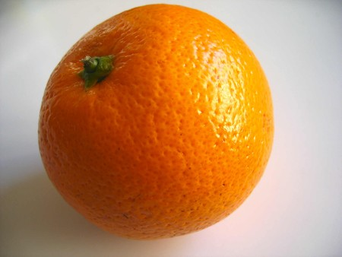
Creating Visual effect using Texture
Simulating Roughness by Bump Mapping
Technique to give surface wrinkled or dimpled appearance without having to model each individual dimple
Independent of the viewing angle and object orientation

Slide 13
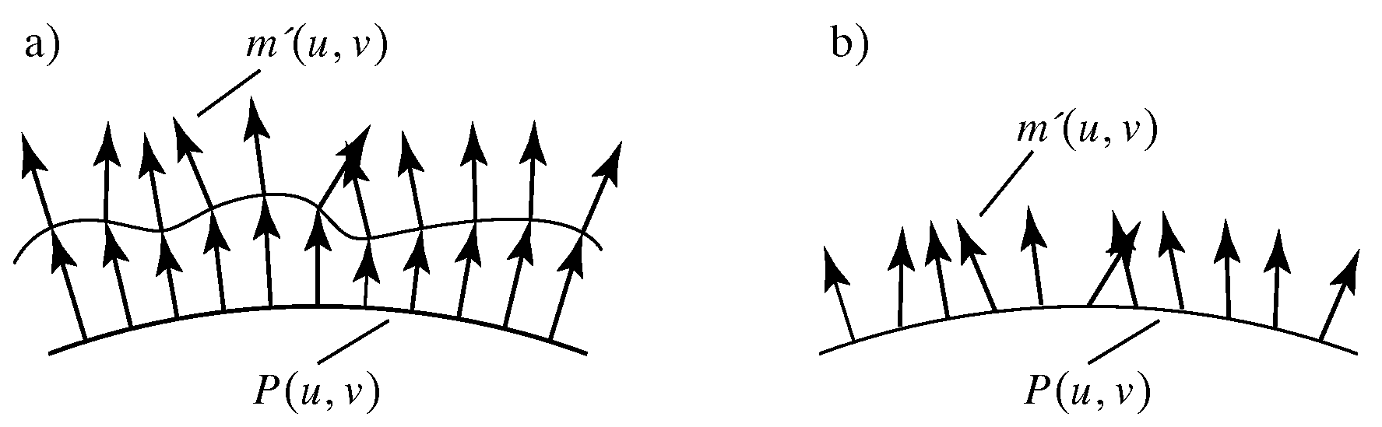
Creating Visual effect using Texture
Simulating Roughness by Bump Mapping
scalar function texture(s, t) perturb the normal vector at each spot in a controlled fashion causes perturbations in amount of diffuse and specular light.

Slide 14
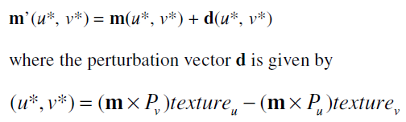
Creating Visual effect using Texture
Simulating Roughness by Bump Mapping
surface is represented parametrically by the function P(u, v)
Surface has unit normal vector m(u, v)
3D point at (u*, v*) corresponds to the texture at (u*, v*)
New normals can be found by:
texture_{u} and texture_{v} are partial derivatives of the texture function with respect to u and v

Slide 15
Shading
The process of assigning colors to pixels.
Shading
Flat Shading
Smooth Shading
Gouraud Shading
Phong Shading

Slide 16
Shading Model
Flat Shading
Compute Phong lighting once for entire polygon
Gouraud Shading
Compute Phong lighting at the vertices and interpolate lighting values across polygon
Phong Shading
Interpolate normals across polygon and perform Phong lighting across polygon

Slide 17
Flat Shading
For each polygon
Determines a single intensity value at a chosen point on the polygon.
Uses that value to shade the entire polygon.
Assumptions
Light source at infinity
Viewer at infinity
The polygon represents the actual surface being modeled

Slide 18
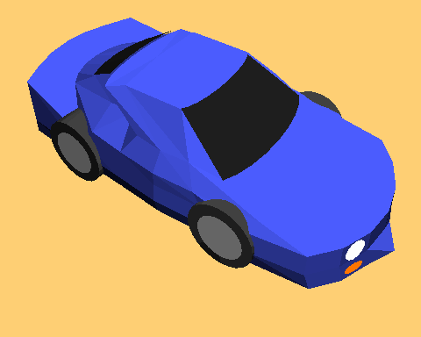
Problems of Flat Shading
Specular highlights tends to get lost
If chosen point on polygon is at location of the light soure, then color of the polygon will be significantly distortes.
Flat Shading

Slide 19
Smooth Shading
Introduce vertex normals at each vertex
Usually different from facet normal
Used only for shading
Think of as a better approximation of the real surface that the polygons approximate
Finds color value for each point in the polygon individually.
Two types
Gouraud Shading
Phong Shading (do not confuse with Phong Lighting Model)

Slide 20
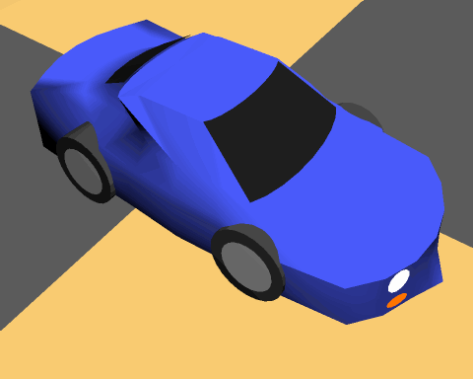
Gouraud Shading
This is the most common approach
Perform Phong lighting at the vertices
Linearly interpolate the resulting colors over faces
Along edges
Along scanline

Slide 21
Gouraud Shading
y_{top}
color₃
y₄
color₄
color₂
y_{s}
y_{bott}
color₁
x_{left}
x_{right}

Slide 22
Gouraud Shading
y_{top}
color₃
y₄
color₄
color₂
y_{s}
y_{bott}
color₁
x_{left}
x_{right}
Calculate the surface normals along the scan line and the edge using incremental approach

Slide 23
Problem of Gouraud Shading
Often appears dull
Lacks accurate specular component
C₁
C₃
C₂
Can’t shade the spot light

Slide 24
Phong Shading
Interpolate normal vectors of face vertices at each pixel, then perform phong lighting at each pixel.
y_{s} - y₁
m_{left} = m₁ + (m₄-m₁)
m₃
Y₄ - y₁
m₄
m₂
m_{left}
m_{right}
m_{x}
y_{s} - y₁
y_{s}
m_{right} = m₁ + (m₂-m₁)
m₁
Y₂ - y₁
x - x_{left}
x
m_{x}= m_{left} + (m_{right} -m_{left})
x _{right} - x_{left}
Calculate the surface normals along the scan line and the edge using incremental approach

Slide 25
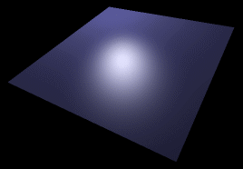
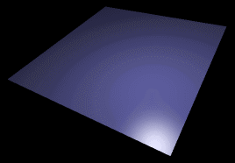
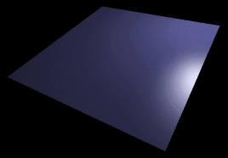
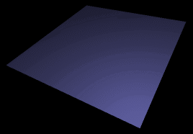
Phong vs Gouraud Shading
Phong Shading is more smooth.
If a highlight does not fall on a vertex Gouraud shading may miss it completely, but Phong shading does not.

Slide 26
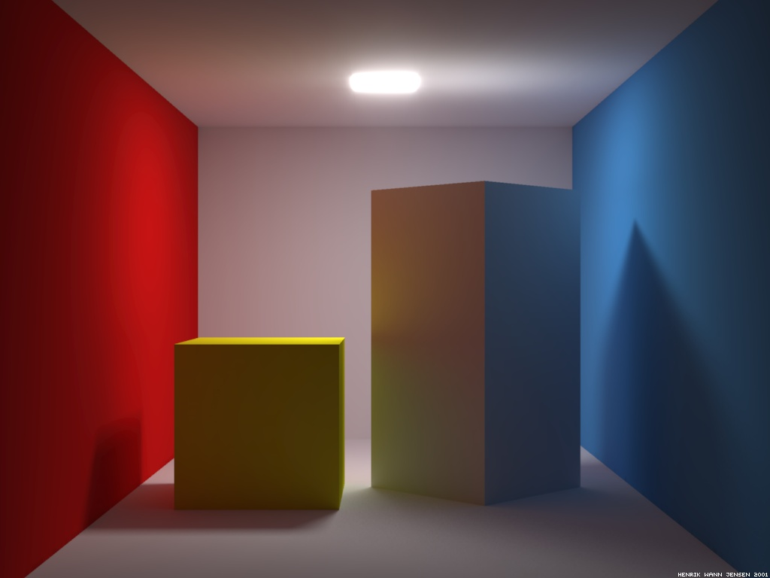
Adding Shadows of Objects

Slide 27
Adding Shadows of Objects
Shadows as Texture
Shadows using a shadow buffer

Slide 28
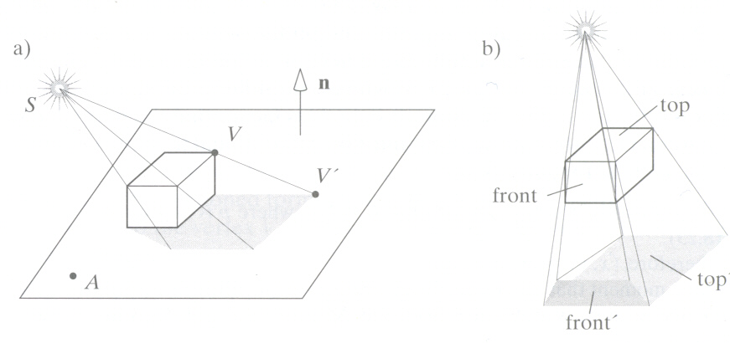
Adding Shadows of Objects
Shadows as Texture:
Paint shadows as a texture
Works for flat surfaces illuminated by point light source
Problem: compute shape of shadow

Slide 29
Adding Shadows of Objects
union of projections of individual faces = projection of entire
Object
Algorithm:
First, draw plane using specular-diffuse-ambient components
Then, draw shadow projections (face by face) using only ambient component

Slide 30
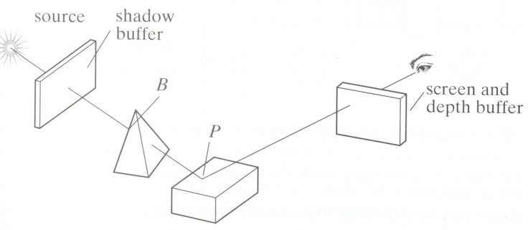
Shadows using a shadow buffer
Shadow Buffer: An auxiliary second depth buffer
Principle:
any points in the scene that are “hidden” from the light source must be in shadow.
if no object lies between a point and the light source the point is not in shadow.

Slide 31
Shadows using a shadow buffer
Shadow buffer:
Contains a “depth picture” of the scene from the point of view of the light source
Each of its index (i, j) records the distance from the source to the closest object in the associated direction.

Slide 32
Shadows using a shadow buffer
Step 1: Loading Shadow Buffer:
Initialize each index value d[i][j] to 1.0
Position a camera at light source
Rasterize each face in scene updating pseudo-depth
Shadow buffer tracks smallest pseudo-depth so far

Slide 33
Shadows using a shadow buffer
Step 1: Loading Shadow Buffer:
Shadow buffer calculation is independent of eye position
In animations, shadow buffer loaded once
If eye moves, no need for recalculation
If objects move, recalculation required

Slide 34
Shadows using a shadow buffer
Step 2: Rendering Scene:
Render scene using camera as usual
While rendering a pixel find:
pseudo-depth D from light source to P
Index location [i][j] in shadow buffer, to be tested
Value d[i][j] stored in shadow buffer
If d[i][j] < D (other object on this path closer to light)
point P is in shadow
set lighting using only ambient
Otherwise, not in shadow

Slide 35
Reference
Hill: sec: 8.3, 8.5.1, 8.5.3, 8.6

